Slide 1
System Development Methods CT00046-3-2
System Implementation

Slide 2
Topic & Structure of the Lesson
System implementation.
Coding strategies.
Software testing.

Slide 3
Learning Outcome
At the end of the module, you should be able to:
Define system implementation.
Describe the coding strategies.
Explain software testing including objectives, methods, and processes.

Slide 4
Key Terms you must be able to use
If you have mastered this topic, you should be able to use the following terms correctly in your assignments and exams:
System implementation.
Coding strategies.
Software testing.

Slide 5
System Implementation

Slide 6
System Implementation
System implementation is the process of constructing the programs and code modules that serve as the building blocks of the information system.
Done when:
The design of the system is approved.
Design Specification is available.
Deliverable
Fully working software / system

Slide 7
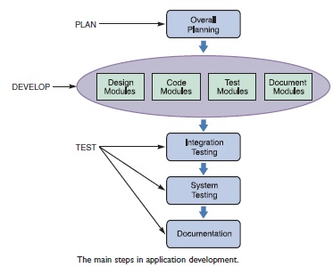
System Implementation (continued)
TRADITIONAL METHODS
After an overall plan and strategy is established, individual modules must be designed, coded, tested, and documented.
A module consists of related program code organized into small units that are easy to understand and maintain.
After the modules are developed and tested individually, more testing takes place, along with thorough documentation of the entire system.

Slide 8
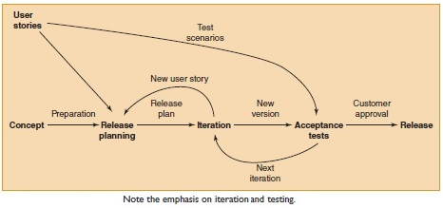
System Implementation (continued)
AGILE METHODS
If you decided to use an agile approach, intense communication and collaboration will now begin between the IT team and the users or customers.
The objective is to create the system through an iterative process of planning, designing, coding, and testing.

Slide 9
Coding Strategies

Slide 10
Coding Strategies Things to Consider Before Coding
Software Architecture to be used / Platform (s)
Types of Platform to build / supported by your application.
Choice Programming Language(s)
The most flexible/compatible language based on your requirements
Programming / Coding Standards
Check whether your coding need to comply with certain standards, IEEE, Open Source, etc.
Types of testing to be carried out.
Type of testing necessary for Pre and Post product deployment.

Slide 11
Coding Strategies Things to Consider Before Coding
User Involvement
Degree of user involvement, availability and user’s expertise
Code Repository
Where to store codes, secure and sharable to other developers.
Version Control
Control of modifications made on codes,
backup and restore or workable codes
Security and Copyright
Level of security implemented for the system / application.
Artifacts that needed to be patented / copyright.

Slide 12
Good Programming Practice
Efficiency
Keep it Short and Simple
Portability
Use good variables and no hard codes
Security
Source Codes, Encapsulation
Readable codes
Meaningful and informative
Names, Comments, Formats

Slide 13
Software Testing

Slide 14
Software Testing
A process of executing a program or application with the intent of finding the software bugs.
A process of validating and verifying that a software program or application or product: Meets the business and technical requirements that guided its design and development.
Any changes in user’s requirements

Slide 15
Verification and Validation
Verification
Validation
Ensuring the correct processes, tools and resources are used in building the product
Are we “building the thing, right?”
To evaluate whether the product meets the customer requirements
Are we “building the right thing?”

Slide 16
Software Testing Objectives
Finding defects / bugs.
Prevent defects (avoid expensive recovery)
Improving level of quality (code and product)
To make sure that the result meets the business and user requirements (in specifications).

Slide 17
Testing Approach
Static Testing
Test and find defects without executing code.
Done during verification process (verify requirements)
Includes techniques - reviewing of the documents, static analysis, reviewing, walkthrough, inspection, etc.
Dynamic Testing
Software code is executed.
Done during validation process (satisfy customers)
Includes test types - Unit Testing, Integration Testing, System Testing, etc.
Recommended – automated testing tools.

Slide 18
Common Testing Terms
White Box Testing
Testing where all INPUT, PROCESS (code functions) and OUTPUT are seen.
Usually tested by the programmer.
Black Box testing
Testing where only INPUT and OUTPUT are seen, PROCESS (internal code and functions) are hidden.
Usually, test by User / Customer.
Stub Testing
Testing just one line of execution, normally to check the presence of data

Slide 19
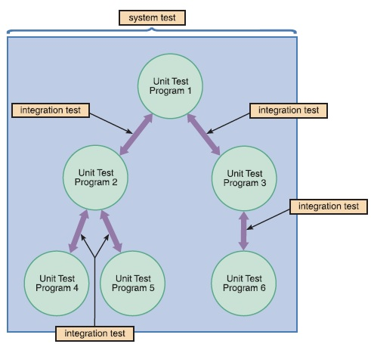
Software Testing Methods
The next step in application development is to initiate a sequence of unit testing, integration testing, and system testing.

Slide 20
Software Testing Methods
Unit testing
Tests that verify the functionality of a specific section of code, usually at the function level.
In an object-oriented environment, this is usually at the class level.
One function might have multiple tests.
The objective is to identify and eliminate execution errors that could cause the program to terminate abnormally, and logic errors that could have been missed during desk checking.
Desk checking is the process of reviewing the program code to spot logic errors, which produce incorrect results. This process can be performed by the person who wrote the program or by other programmers.
Many organizations require a more formal type of desk checking called a structured walkthrough, or code review.
Variation of white-box testing

Slide 21
Software Testing Methods (continued)
Integration testing
Testing two or more programs that depend on each other is called integration testing, or link testing.
For example, consider an information system with a program that checks and validates customer credit status, and a separate program that updates data in the customer master file. The output from the validation program becomes the input to the master file update program.
Testing the programs independently does not guarantee that the data passed between them is correct.
Only by performing integration testing for this pair of programs can you make sure that the programs work together properly.

Slide 22
Software Testing Methods (continued)
System testing
After completing integration testing, you must perform system testing, which involves the entire information system.
During a system test, users enter data, including samples of actual, or live, data, perform queries, and produce reports to simulate actual operating conditions.
All processing options and outputs are verified by users and the IT project development team to ensure that the system functions correctly.

Slide 23
Software Testing Methods (continued)
System testing has the following major objectives:
Perform a final test of all programs
Verify that the system will handle all input data properly, both valid and invalid
Ensure that the IT staff has the documentation and instructions needed to operate the system properly and that backup and restart capabilities of the system are adequate
Demonstrate that users can interact with the system successfully
Verify that all system components are integrated properly and those actual processing situations will be handled correctly
Confirm that the information system can handle predicted volumes of data in a timely and efficient manner

Slide 24
Other Testing Methods
Installation Testing
assures that the system is installed correctly
Compatibility Testing
compatibility with other application software, operating systems
Smoke And Sanity Testing
determines whether it is reasonable to proceed with further testing
Regression Testing
focuses on finding defects after a major code change has occurred.
Acceptance Testing
performed by the customer for approval and feedback

Slide 25
Other Testing Methods
Alpha Testing
simulated or actual operational testing by potential selected / internal users
Beta Testing
after alpha testing, Beta testing is a form of external user acceptance testing
Destructive / Robust Testing
test software durability and tolerance.
Security Testing
for software that processes confidential data to prevent system intrusion.

Slide 26
Testing Tools
The following are software testing tools that help in conducting testing tasks
Program monitors
Permitting full or partial monitoring of program code
Examples: Instruction set simulator, Hypervisor, Program animation, etc.
Formatted dump or symbolic debugging
Tools allowing inspection of program variables on error or at chosen points
Automated functional GUI
Testing tools are used to repeat system-level tests through the GUI
Benchmarks Tools
Allowing run-time performance comparisons to be made with rivals
Performance analysis (Profiling tools)
Tools that can help to highlight hot spots and resource usage

Slide 27
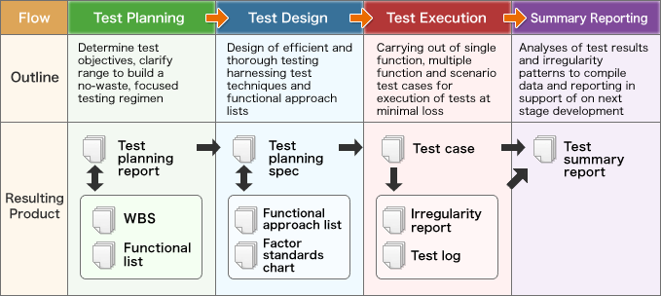
Software Testing Process
The general process when conducting software testing starting from planning, test design, execution, and reporting - as shown in the figure below:

Slide 28
Test Plan
A test plan consists of detailed procedures that specify how and when the testing will be performed, who will participate, and what test data will be used.
Used as a guide to testing software.
Include test case and uses test data (sample data).
Test data should contain both correct data and erroneous data and should test all possible situations that could occur.
For example, for a field that allows a range of numeric values, the test data should contain minimum values, maximum values, values outside the acceptable range, and alphanumeric characters.
Usually prepared before the software is built.
Prepared by ‘software testers’.

Slide 29
Test Plan (continued)
Test case
Test data
The data that will be used for a test case
a formal description of:
a set of starting states and events used to test a module, group of modules, or entire system
a starting state,
one or more events to which the software must respond
expected response or ending state

Slide 30
Test Plan - Example
TEST DATE / TIME: |  |  | PROJECT ID:
TEST BY: |  |  | SYSTEM TITLE:
TEST CASE | TEST TYPE | TEST STEPS | EXPECTED RESULT | ACTUAL RESULT | REMARKS
1. User Sign-in | Unit Test | Open application Enter User Name as “X” and ……. | User successfully signed-in into the system, welcome page displayed. | Error – does not show error when ‘space’ is used in ID | Correction made to code to check ID validity.
2. Update User Profile

Slide 31
Summary
System implementation is the process of constructing the programs and code modules when the design is approved and available.
System testing is a process of validating and verifying a system using various tools and techniques include unit testing, integration testing, system, testing, etc. It aims to resolve errors, prevent errors and improve system quality.
Verification helps to ensure the correct processes, tools, and resources are used in building the system. Whilst validation helps to evaluate whether the system meets the customer requirements.
The test plan includes a test case (one or more events to which the software must respond and expected response) and test data (data that will be used for a test case).

Slide 32
Question & Answer

Slide 33
Next Session
System Deployment

